Slide 1
Supply Chain
Infographics
Loo Guan Yee
October 2024

Slide 2
Objective
Data Co Global is an e-commerce platform offering end-to-end product fulfilment to customers with its integrated supply chain.
Each stage in the supply chain plays a pivotal role in reducing operational costs, maximizing customer satisfaction, and maintaining a healthy profit margin.
For e-commerce platforms like DataCo, it is essential to use data analytics to analyse the DataCo Global operations.
This presentation will:
Outline the data collected from various supply chain stages and the preprocessing methods applied.
Uncover key insights by analysing the upstream and downstream supply chain processes.
Provide recommendations based on the derived insights to enhance overall efficiency, optimize costs, and improve customer satisfaction.

Slide 3
Data Acquisition
01
Data
Acquisition
02
Data Preprocessing
03
Data
insights
04
Recommendations

Slide 4
Data Description
Contained 180,519 Data Co orders from January 2015 to February 2018 based in the USA and Puerto Rico collected by Universidad Central del Ecuador
Contained the Sales and Profits (Benefit per order) and the following information with their respective hierarchies
Product Purchased
Product Department
Product Category Department
Product Name
Payment Method
Transfer
Cash
Debit
Payment
Shipping Method
Same Day
First Class
Second Class
Standard
Order Destination
Market
Market Region
Market Country
01
02
03
04

Slide 5
Data Preprocessing
01
Data
Acquisition
02
Data Preprocessing
03
Data
insights
04
Recommendations

Slide 6
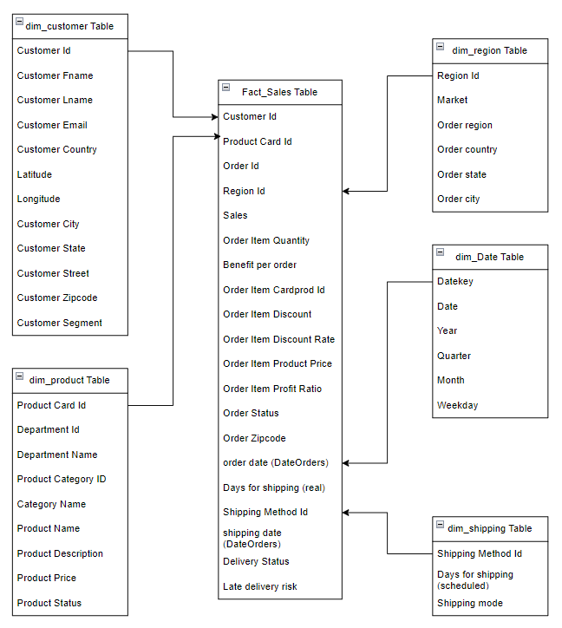
Data Preprocessing
Converted the dataset into the star schema for faster analytics workload
Stored the data and star schema in the PostgreSQL server
Processed the respective dimension and fact tables in Power BI
Customer (Dimension)
Combined Customer First and Last Name
Replaced erroneous Customer State 91732 (El Monte) and 95738 (Elk Grove) with the correct state CA
Product (Dimension)
Changed product price to Price Category
Region (Dimension)
Replaced the Spanish countries’ names with their English names
Reordered Pacific Asia to Asia Pacific
Shipping (Shipping)
Sales (Fact)
Rounded off the Sales, Benefits Per Order, and Order Item Discount to 2 decimal places
Cleaned the Payment Type and Delivery Status text columns
01
02
03
04

Slide 7
Data Insights
01
Data
Acquisition
02
Data Preprocessing
03
Data
insights
04
Recommendations

Slide 8
Data Fusion Methodology
The DataCo analysis prioritised the Market and products with complete data from 2015 to 2017.
The DataCo dataset was analysed in the following order.
Sales
Profit Margin derived from the Benefit Per Order and Sales column
On-Time Performance (OTP) of Shipping Method from the Delivery Status column
Suspected Fraud transaction monitoring from the Order Status column
01
02
03
04

Slide 9
Data Insights
01
Data
Acquisition
DataCo Eccomerce
Platfrom Sales
02
Data Preprocessing
03
Data
insights
04
Recommendations

Slide 10
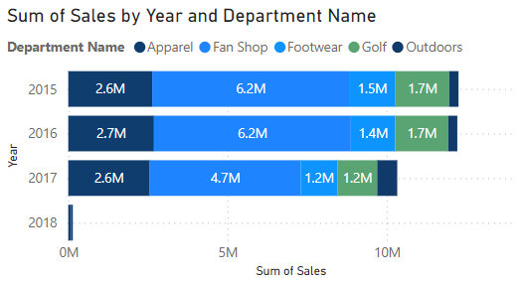
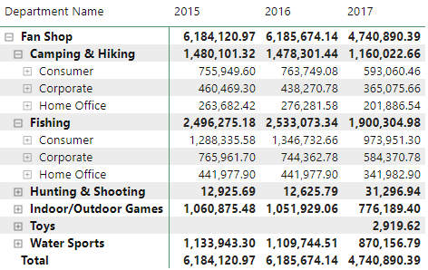
The fan shop revenue has decreased from 2016 to 2017.
The Camping & Hiking, and Fishing, contributing to most of the fan shop revenue had decreased significantly from 2016 to 2017.
Caused by a reduction in revenue of these Product Categories in Asia Pacific and African markets due to the Cholera/Ebola epidemic or extreme natural weather events.
Prioritise Product Departments and Categories with less volatility
01
02
03
04

Slide 11
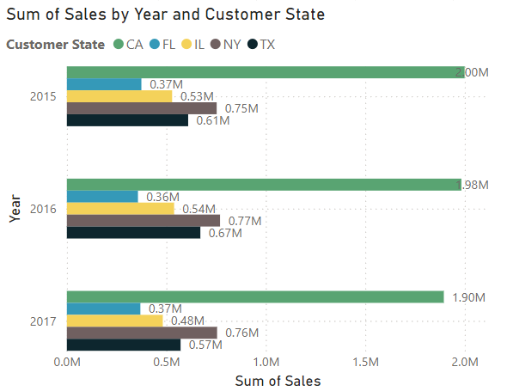
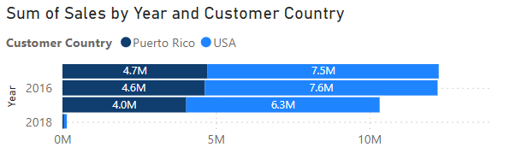
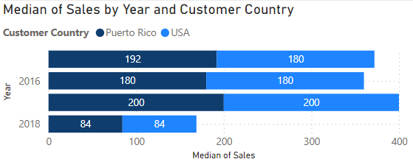
The average revenue per customer has increased from 2016 to 2017 despite revenue decreases from the USA and Puerto Rico.
The overall revenue decreased for both the USA and Puerto Rico from 2016 to 2017
In the USA, the Majority Revenue generator states CA, FL, IL, NY and TX have decreased from 2016 to 2017
However, the average spending per transaction has increased from 2016 to 2017. This might indicate:
Customers shifting preference towards premium or quality products
Success marketing of the Data Co platform in instilling customer confidence to purchase expensive products for their safety and convenience
01
02
03
04

Slide 12
Data Insights
01
Data
Acquisition
DataCo E-commerce
Profit Margin
02
Data Preprocessing
03
Data
insights
04
Recommendations

Slide 13
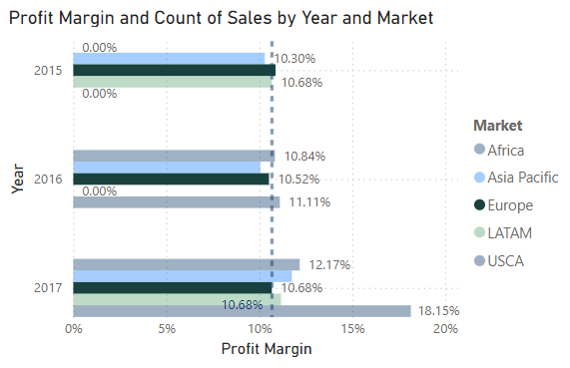
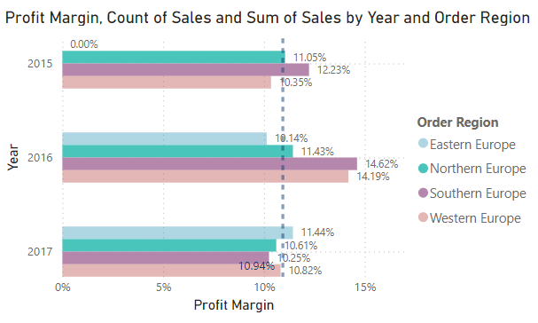
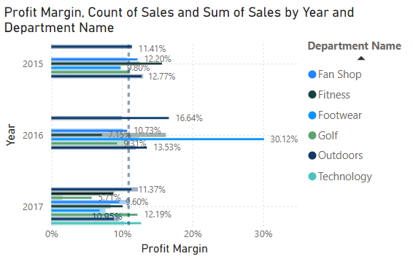
Europe has the lowest profit margin from 2015 to 2017.
All markets have an average of 10.68% profit margin from 2015 to 2017.
Europe’s profit margin decreased from 2015 to 2017
Northern and Southern Europe with larger sales had lower profit margin in 2017
Bookshop (8.74%), Fanshop (9.60%), Footwear (6.84%), Outdoors (8.5%)and Golf (5.17%) contributed to the reduction in the profit margins in 2017
Prioritise the products with product margin that are more than 10%
01
02
03
04

Slide 14
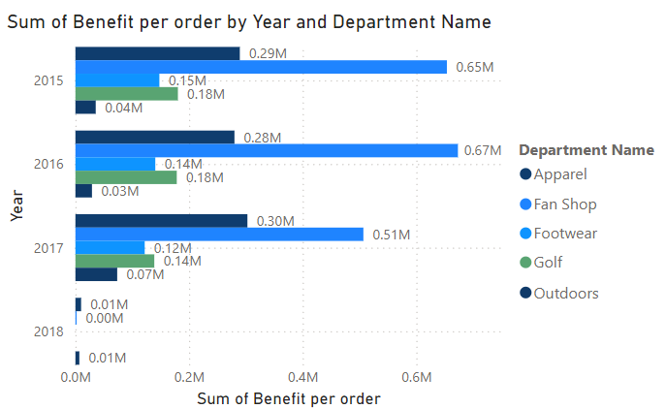
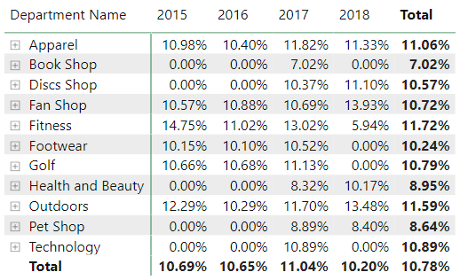
Except for Bookshop, Petshop and Fitness (2017), most products have profit margins above 10%.
The DataCo platform hosts products with healthy profits and profit margins
The Product Department affects the DataCo profit margins significantly
Promote the sales of Products with more than a 10% margin on the DataCo Platform to maintain high profit margins
01
02
03
04

Slide 15
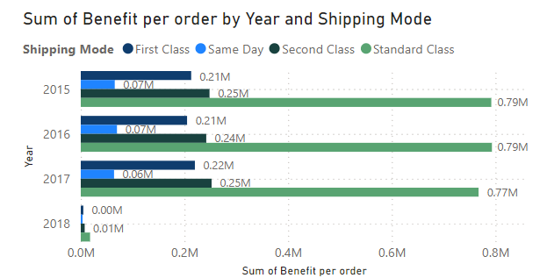
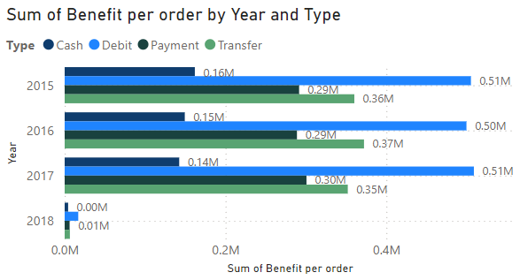
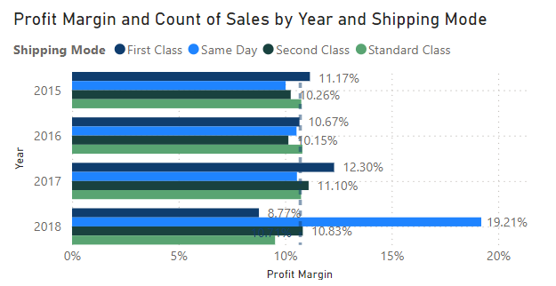
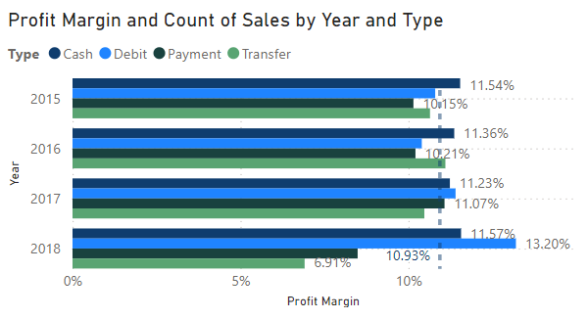
The shipping and payment methods do not affect the profit margin.
This means that only the product and region will affect the profit margin
This provides flexibility for the DataCo to adapt shipping methods to suit the customers’ needs and satisfaction with the product being on time without affecting profit margins
01
02
03
04

Slide 16
Data Insights
01
Data
Acquisition
DataCo E-commerce
On Time Performance
02
Data Preprocessing
03
Data
insights
04
Recommendations

Slide 17
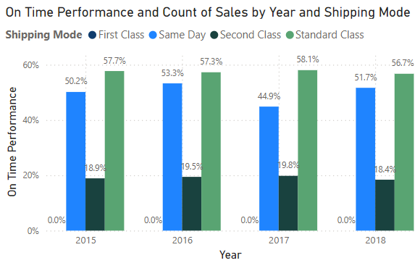
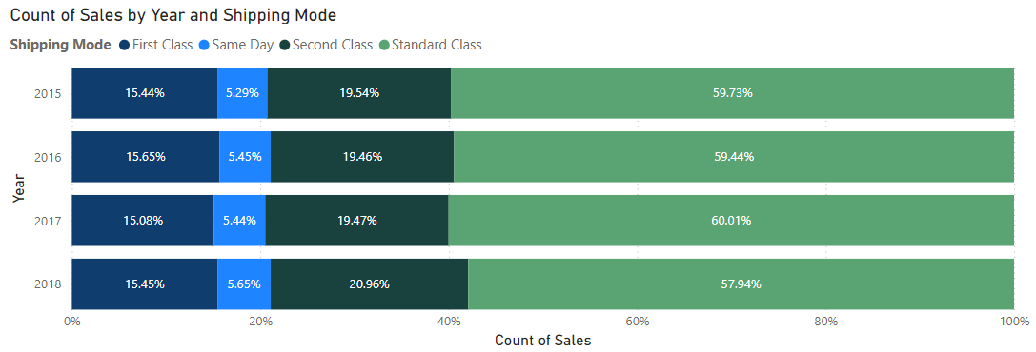
The OTP for Same-Day shipping method has reduced from 53.3% in 2016 to 44.9% in 2017.
The Standard Class is the most popular and punctual shipping method on the DataCo Platform.
There is a reduction in the Same-Day shipping method OTP from 2016 to 2017.
Europe contributed to the reduction in the Same Delivery OTP from 2016 to 2017.
01
04

Slide 18
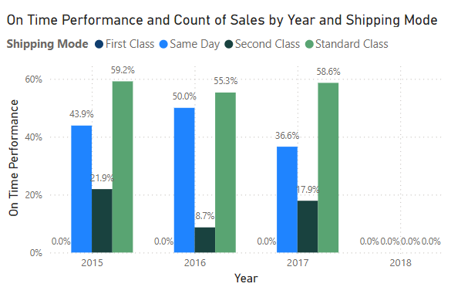
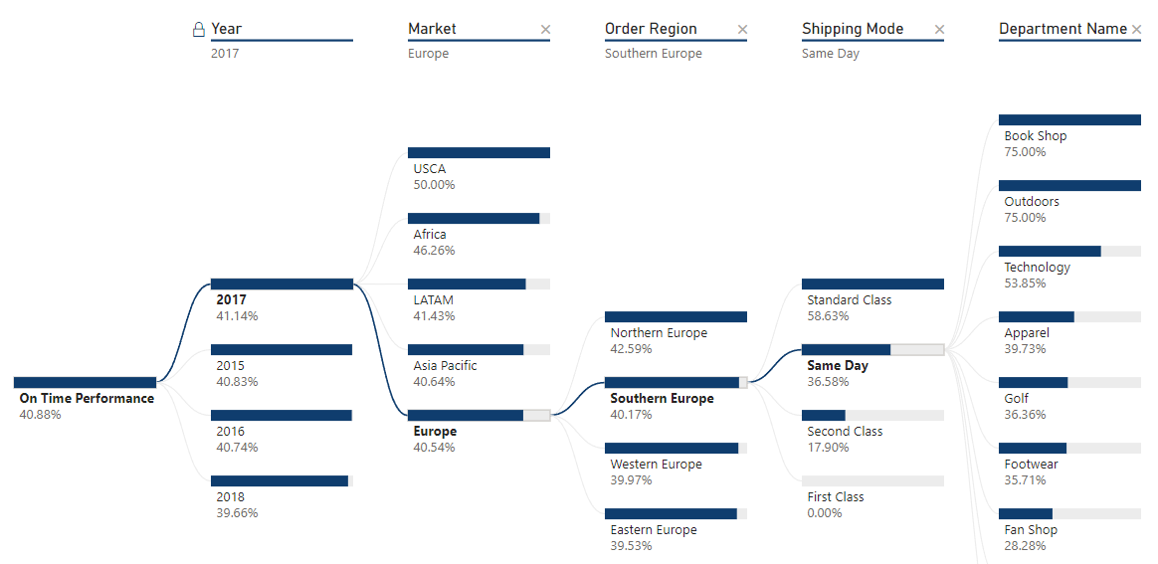
The Same-Delivery OTP from the Southern Europe Market has dropped from 50% to 36.6%.
Product Department Apparel, Golf, Footwear and Fan shop contributed to a reduction in the Southern Europe Same Day OTP.
This could be due to the Railway closure in Germany connecting to Southern Europe in late September 2017
Providing alternate switches to other shipping modes to anticipate railway closure
01

Slide 19
Data Insights
01
Data
Acquisition
DataCo E-commerce
Fraud Transaction Monitoring
02
Data Preprocessing
03
Data
insights
04
Recommendations

Slide 20
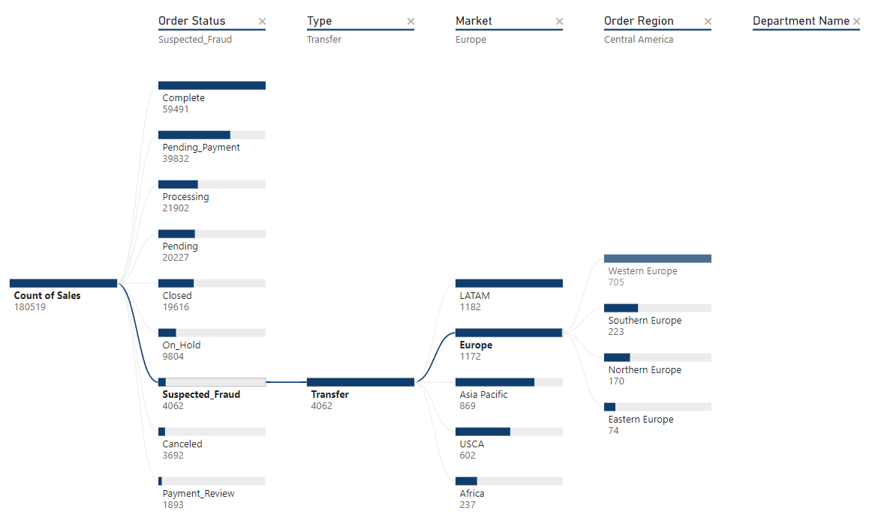
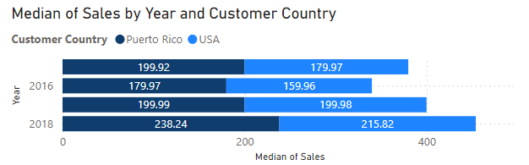
All the suspected fraud cases came from the Transfer payment method.
The flagged orders had lower median sales values compared to those non-flagged orders.
LATAM and Europe had the most suspected_fraud cases
In particular, most of the orders’ market destination with Western Europe was tagged as suspected_fraud.
Perform additional scrutiny of those orders’ destination
01
02
03
04

Slide 21
Recommendations
01
Data
Acquisition
02
Data Preprocessing
03
Data
insights
04
Recommendations

Slide 22
Recommendations
Insight 1: Fan shop products are susceptible to changes in the Asia Pacific and Africa
Enhance the marketing of Fan Shop products in other markets to cushion the decrease in Asia Pacific and Africa
Insight 2: Europe has the lowest profit margin from 2015 to 2017
Promote the products with higher profit margins in Europe
Insight 3: Bookshops, Petshop and Fitness have lower Product department margins
Promote bulk sales to increase the profit margins of these departments
Insight 4: Europe has a dropped in the OTP for Same Day Delivery
Plan alternate transportation routes (railway or highway) to account for potential disruption in any connection
Insight 5: All Suspected fraud transactions come from the transfer payment method
Monitor orders towards LATAM market and Western Europe regions in the European Market
Monitor origin orders with sales amount that exceeds the median amount of $84 in 2018
01

Slide 23
Limitations
Missing data for some of the years in the data for products and Market Regions
Puerto Rico states are not available for analysis
01

